Slide 1

Scalable JavaScript Application Architecture
SoftServe
Ability.
Agility.
Advantage.

Slide 2
“May you live in interesting times.”
–Traditional Chinese Curse

Slide 3
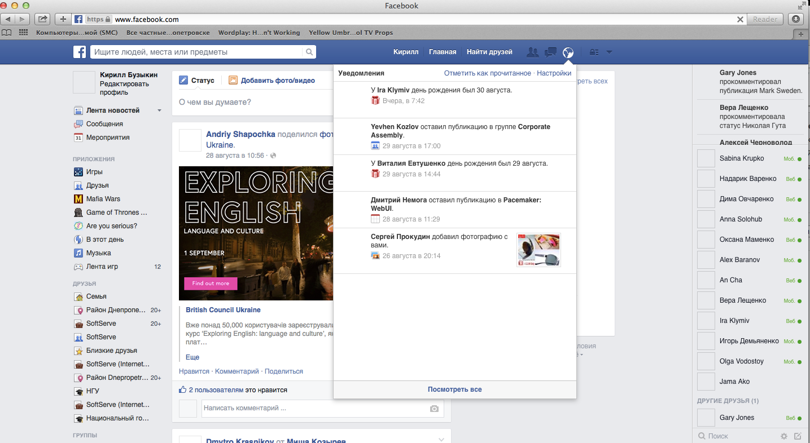
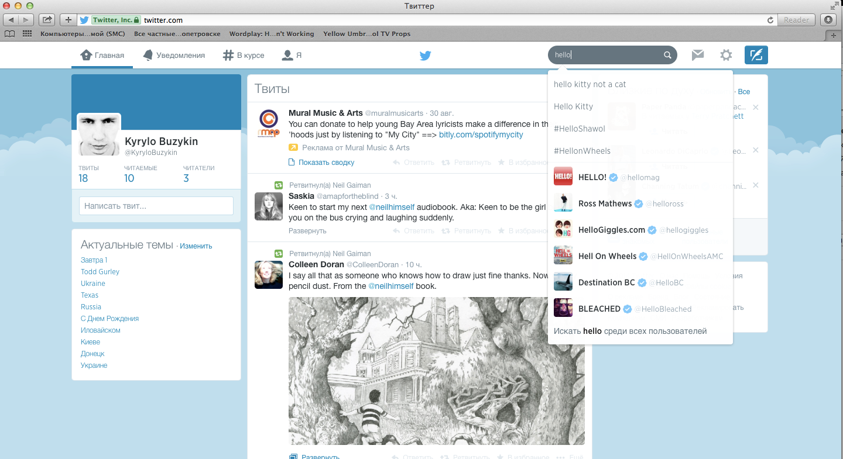
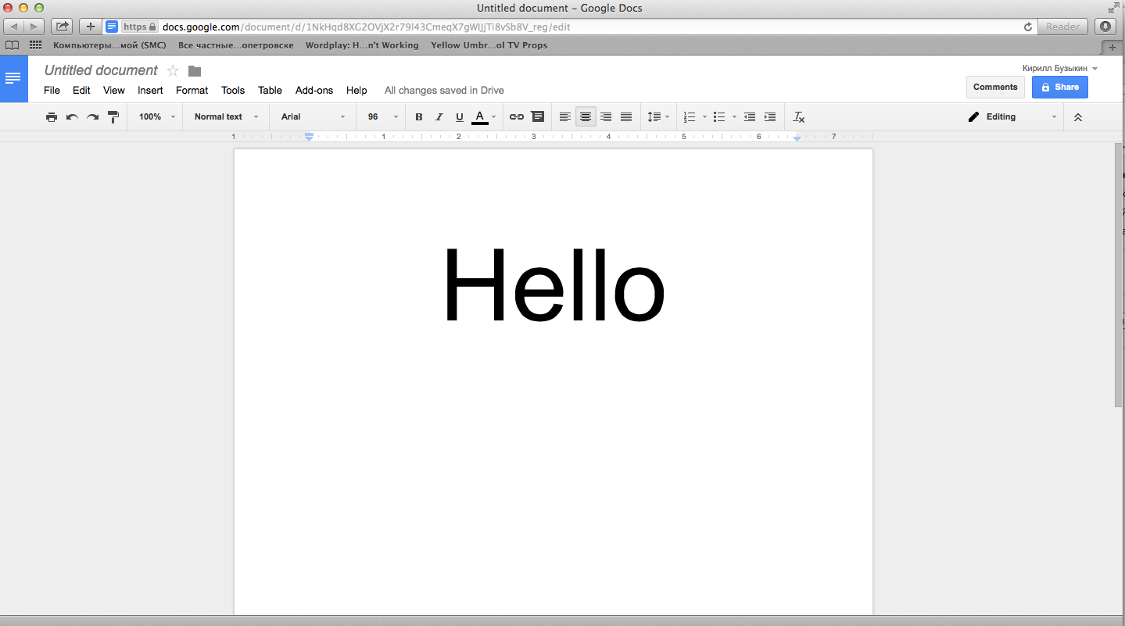

Slide 4
“I will think about UI architecture tomorrow … maybe …”
–Unemployed Architect

Slide 5
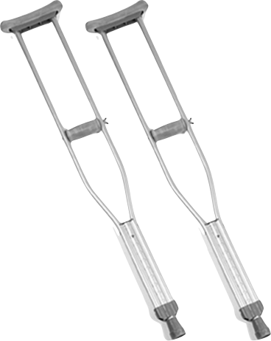
we will do that
We are professionals

Slide 6
how to avoid such?

Slide 7


Slide 8
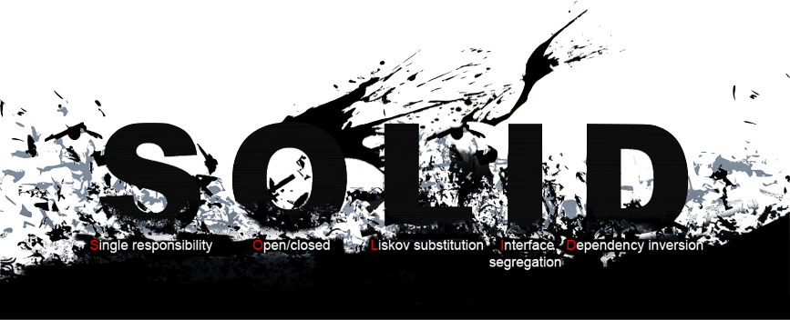
solid
(Single responsibility, Open-closed, Liskov substitution, Interface segregation and Dependency inversion)

Slide 9
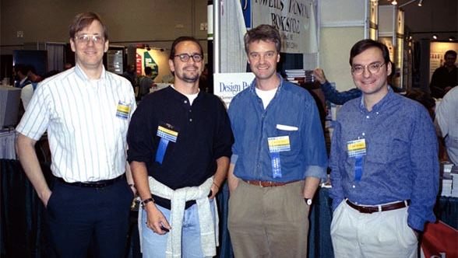
Gof design patterns
Richard Helm, Erich Gamma, Ralph Johnson, and John Vlissides

Slide 10
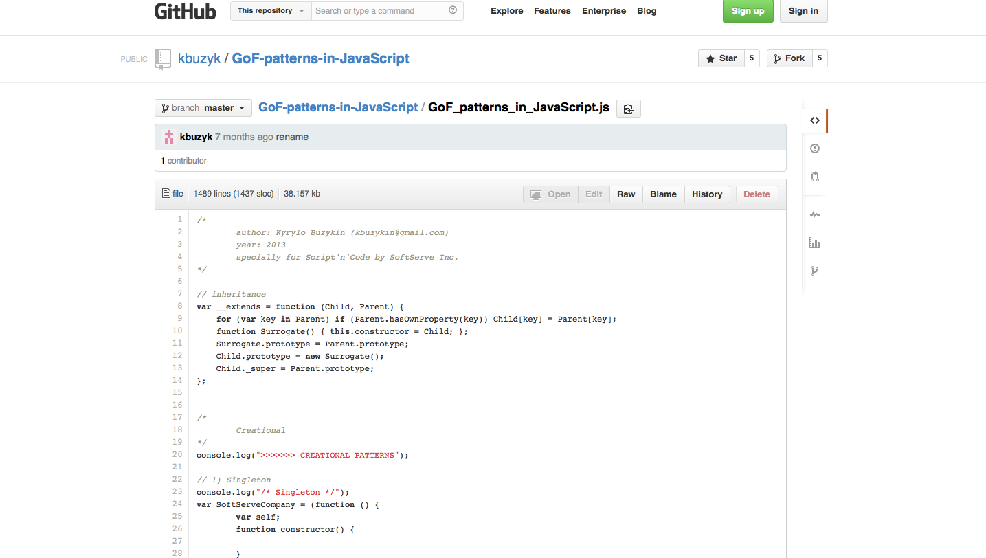
GoF Patterns in JavaScript
https://github.com/kbuzyk/GoF-patterns-in-JavaScript/blob/master/GoF_patterns_in_JavaScript.js

Slide 11

separation of concerns
savvy?

Slide 12

N-tier architecture - MV* | mvW
MVC | MCP | MVVM

Slide 13
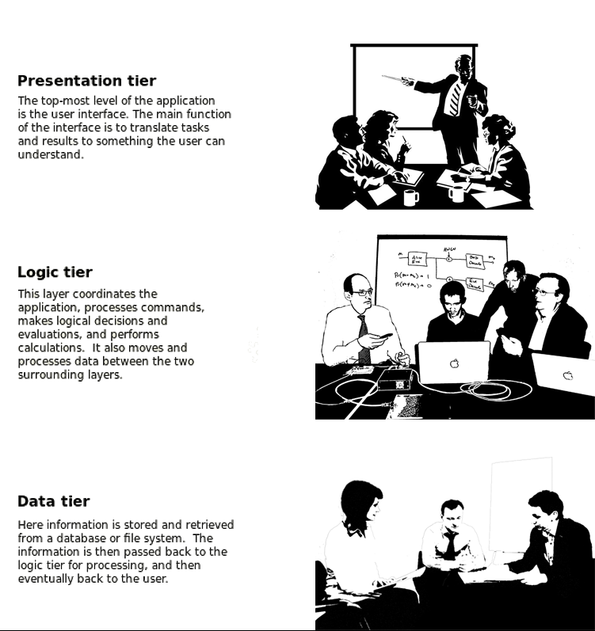
Three-tier application

Slide 14
layer
layer
layer
Three-tier application

Slide 15


application data,
business rules,
logic,
functions
MODEL
updates
manipulates
VIEW
CONTROLLER
sees
uses
USER
accepts input
and converts it to
commands for
the model or view
output representation of information;
listens user's events
MVC

Slide 16
accepts input
and converts it to
commands for
the model or view;
business rules,
logic,
functions;
contains UI business logic for the view
PRESENTER
passes calls to
manipulates
updates
notifies
VIEW
MODEL
uses
sees
output representation of information
USER
application data
MVP

Slide 17
accepts input
and converts it to
commands for
the model or view;
business rules,
logic,
functions;
contains UI business logic for the view
ADAPTER
passes calls to
manipulates
updates
notifies
VIEW
MODEL
uses
sees
output representation of information
USER
application data
MVA

Slide 18
ADAPTER
ADAPTER
ADAPTER
passes calls to
manipulates
updates
notifies
VIEW
MODEL
uses
sees
USER
MVA

Slide 19
application data,
business rules,
logic,
functions
MODEL
updates
listens
serves in
mediating
between the
view and the
model
VIEWMODEL
listens
updates
output
representation
of information;
listens user's
events
VIEW
uses
sees
USER
MVVM

Slide 20
application data,
business rules,
logic,
functions
MODEL
updates
listens
serves in
mediating
between the
view and the
model
BINDER
listens
updates
output
representation
of information;
listens user's
events
VIEW
uses
sees
USER
MVB

Slide 21
separation of concerns
again, doh?…

Slide 22
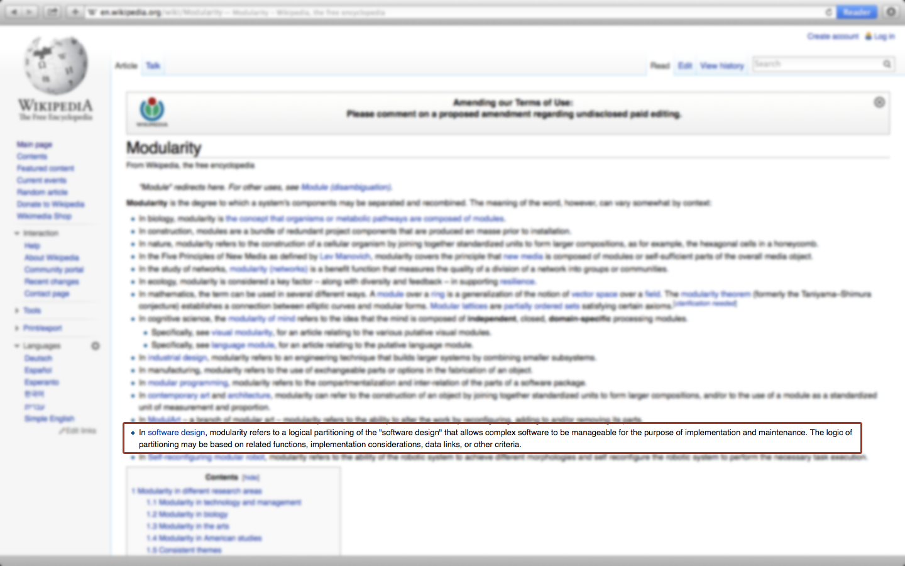
Modularity
In software design, modularity refers to a logical partitioning of the "software design" that allows complex software to be manageable for the purpose of implementation and maintenance. The logic of partitioning may be based on related functions, implementation considerations, data links, or other criteria.
as Wikipedia says

Slide 23
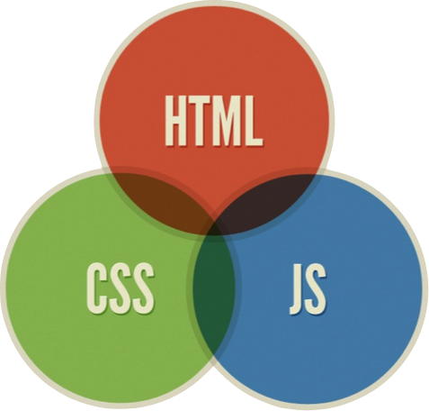
Modularity
in UI

Slide 24
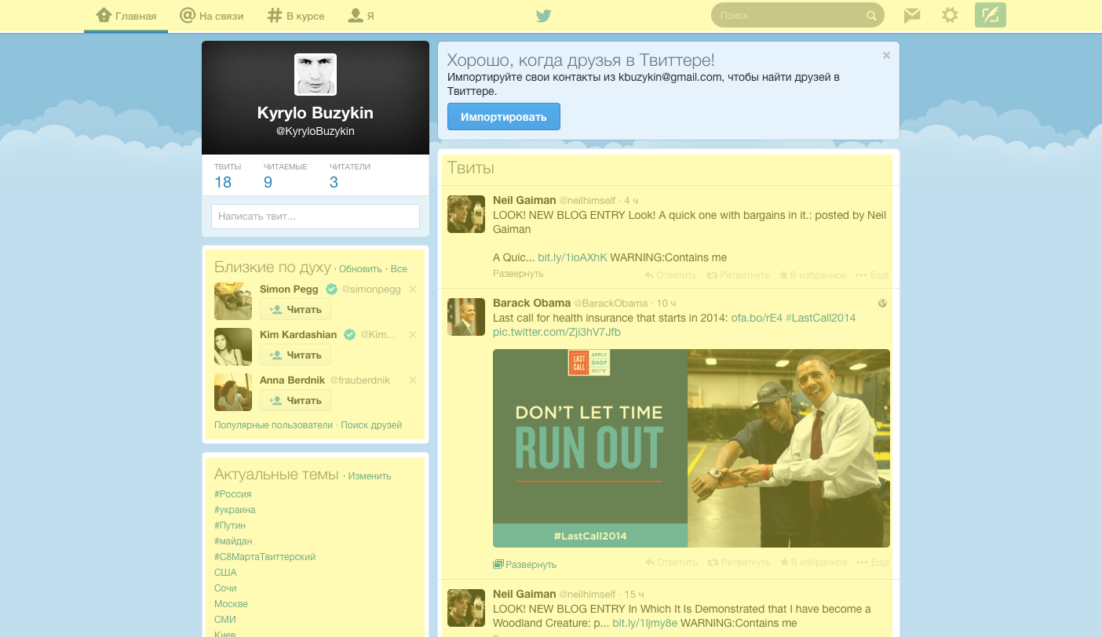
Modularity
in Life

Slide 25
Extension
Extension
Base Library
Scalable JS Application

Slide 26
Extension
Extension
Application Core
Extension
Extension
Base Library
Scalable JS Application

Slide 27
Sandbox
Extension
Extension
Application Core
Extension
Extension
Base Library
Scalable JS Application

Slide 28
Module
Module
Module
Module
Module
Sandbox
Extension
Extension
Application Core
Extension
Extension
Base Library
Scalable JS Application

Slide 29
Triada (Agent)
CONTROLLER
MODEL
VIEW
Module
Scalable JS Application

Slide 30
Level 3
Module
Level 2
Module
Module
Module
Level 1
Module
Module
Application Core
Scalable JS Application

Slide 31
Level 3
Module
Level 2
Module
Module
Module
Level 1
Module
Module
Application Core
Scalable JS Application

Slide 32
Level 3
Module
Level 2
Module
Module
Module
Level 1
Module
Module
Sandbox
Scalable JS Application

Slide 33
Level 3
Module
Level 2
Module
Module
Module
Level 1
Module
Module
Sandbox
Scalable JS Application

Slide 34
backbone
library, not a framework

Slide 35
provides
Model (and Collection of models)
View
Routing
Events (can be used as ViewModel)
Else do as you wish

Slide 36
ember
A framework for creating ambitious web

Slide 37
provides
Model
View
Routing
Controller
Bindings
Else do as you wish

Slide 38
knockout
just implements Two-Way Data Binding

Slide 39
provides
ViewModel
Model (as simple JS Object)
View (as HTML)
Else do as you wish

Slide 40
kendo
Kendo UI
Everything you need to build modern sites and apps with HTML5/JS

Slide 41
Kendo UI
provides
ViewModel
Model (as simple JS Object)
View (as HTML)
Build-in Widgets
Else do as you wish

Slide 42

canjs
with modern features like custom tags and 2-way binding

Slide 43
provides
Model
View
Routing
ViewModel
Else do as you wish

Slide 44
extjs
JavaScript framework with an MVC/MVVM architecture and modern UI widgets

Slide 45
provides
View
Model (as Models and Stores)
Controller
ViewModel
Routing (via Controllers)
ViewController
Build-in Widgets
Else do as you wish

Slide 46
angular
superheroic JavaScript MVW framework

Slide 47
provides
View (as HTML and Directives)
Controller (witch plays role of Presenter and ViewModel)
Routing
Model (as JS object or Service)
Modularity
More interesting, huh?

Slide 48
pros and cons
scalability
maintainability
testability
extensibility
flexibility
modifiability
reusability
understandability
…
etc.
understandability
performance

Slide 49
questions?

